Slide 1
Time Management System
Harsh chandel

Slide 2
Introduction
This software , Time Management System, is aimed to allow an organization’s executives to maintain their day to day schedules and also allows the organization to view statistics related to various projects and its employees.

Slide 3
Users
The Time Management System is aimed for following groups of users:-
1. Executives and their secretaries.
2. The organization’s admins.

Slide 4
Tech Stack Used
1. Java programming language was used to implement the Software System.
2. Apache NetBeans Interactive Development Environment (IDE) was used.
3. MariaDB was used to provide persistent storage to the System.

Slide 5
Organization of Software
1. The first group of users (i.e. the executives and their secretaries ) are provided various functionalities to view schedule, book slots to manifest their unavailability, organize meetings, delete events in order to allow rescheduling.
2. The second group of users (i.e. the company admins ) are provided in their dashboard the features to view statistics related to a particular project or an employee, control access rights related to an account of a particular executive and register new executives.

Slide 6
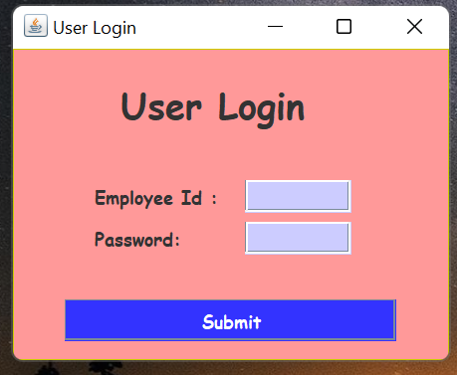
LOGIN PAGE
On starting the software , a login window is displayed, which prompts the user to enter credentials. This window allows a user to login either as an admin or an executive provided he/she has the correct credentials.

Slide 7
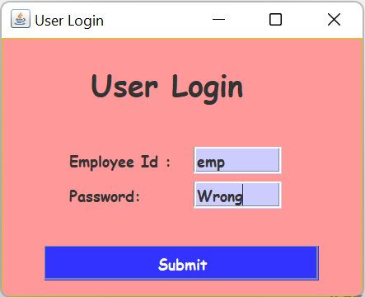
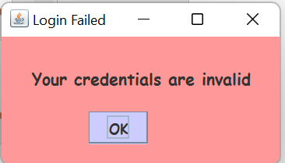
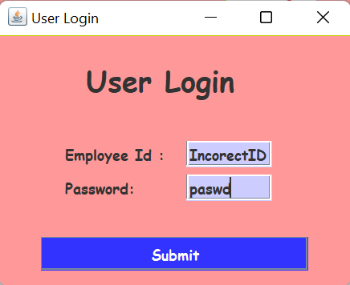
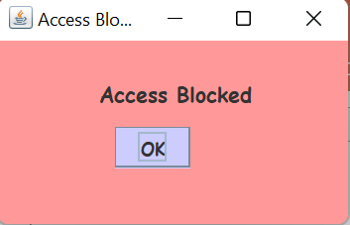
Incorrect Credentials
However on entering wrong credentials ,an error message is displayed showing the “Invalid Credentials ” when the Id is correct but password is wrong , in the case when the Id itself is incorrect , “Access Blocked ” message is diplayed

Slide 8
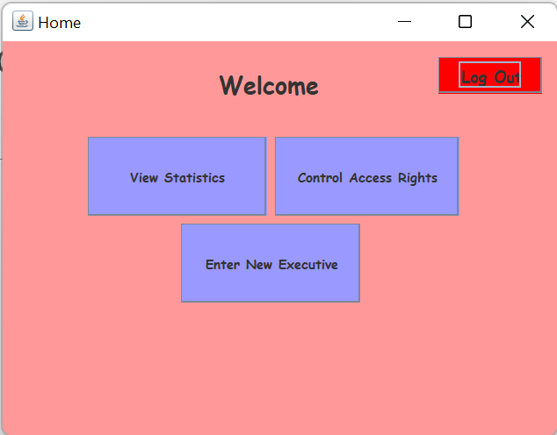
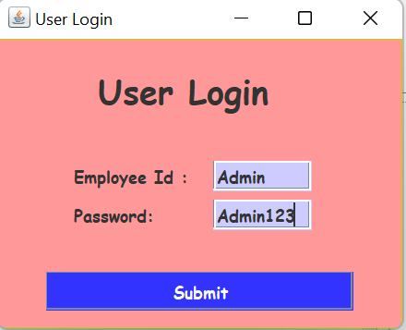

Logging in as Admin
On entering correct Admin Credentials , the user is taken
to the Admin Dashboard.

Slide 9
ADMIN INTERFACE

Slide 10
Admin Interface
As already mentioned, admin is provided the following functionalities:-
1. View Statistics
2. Control Access Rights
3. Register New Executive

Slide 11
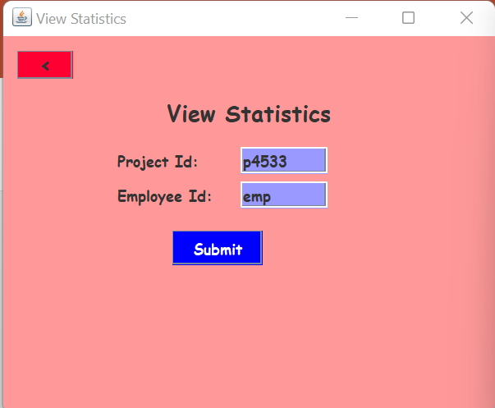
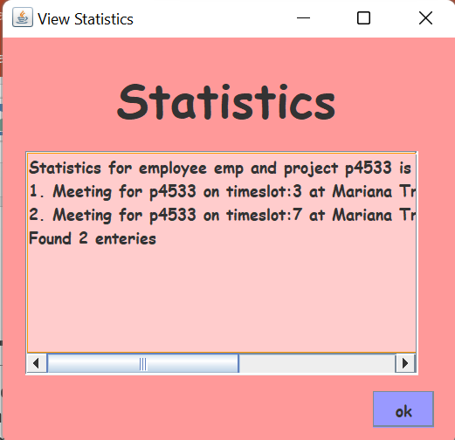

1. View Statistics
On entering either the correct project Id or executive Id or both the Admin is shown statistics related to meetings associated with the project ,or the meetings associated with an executive or meetings associated with a particular executive on a particular project respectively.

Slide 12
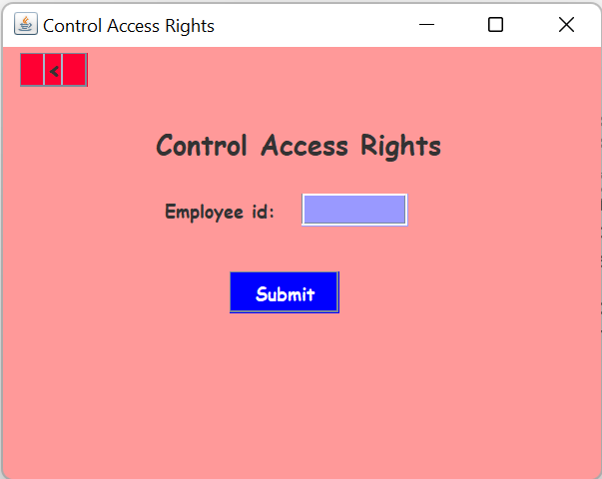
2.Control Access Rights
This feature allows the admin to control access rights of a particular executive so that the executive may only be allowed to view his schedule, or may be allowed to organize events or he/she may be prohibited from accessing his/her account altogether.
The Admin must first enter the employee Id whose access rights need to be changed, On clicking the Control Access Rights button on Admin Dashboard, he is prompted to enter the employee Id as shown below

Slide 13
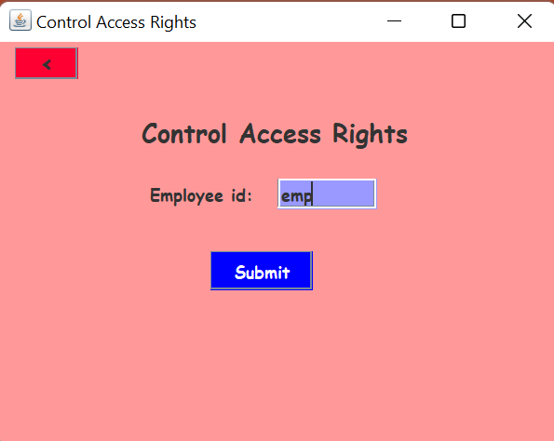
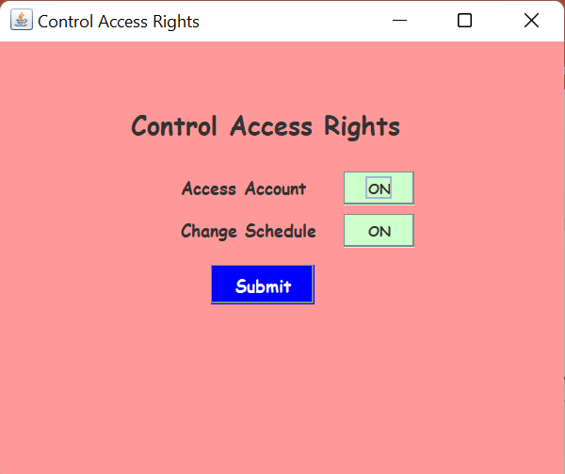

2.Control Access Rights
On entering the correct executive Id , Admin is taken to next screen where he can control the rights to access account or the rights to introduce changes to schedule.
Green button – Off state Dark Green – On state

Slide 14
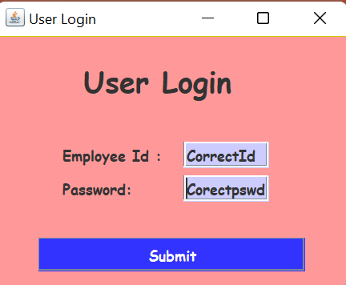
2.Control Access Rights (Account access blocked)

Slide 15
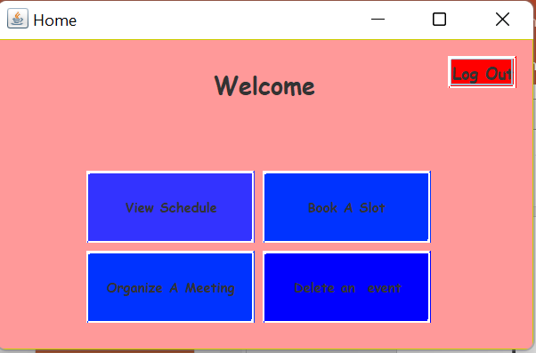

2.Control Access Rights(Schedule Change Prohibited)
An executive whose change schedule right is disabled by Admin, cannot use book a slot and organize meetings or delete events to introduce changes in schedule.
On clicking these buttons “access blocked” message is displayed.
Click on Organize Meeting

Slide 16
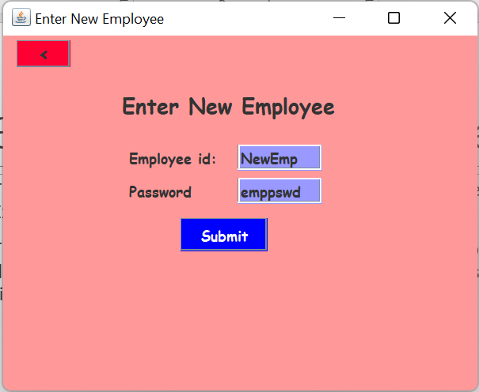
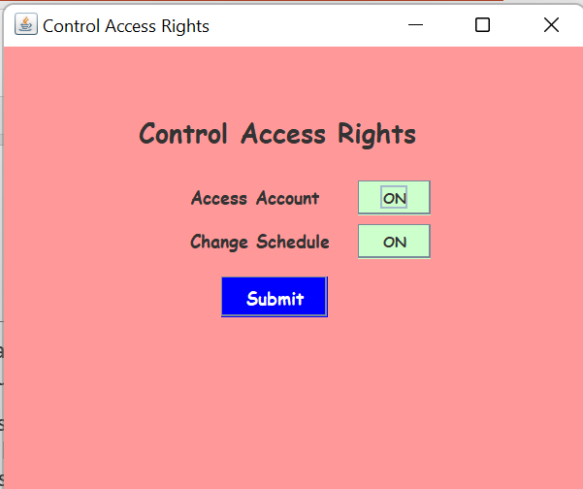


3. Register New Executive
The admin is also provided the privilege to register new executives by clicking the “Enter New Executive” button on the dashboard.
This screen is shown in which he can create credentials for a new executive. On entering valid details in this window the Admin is taken to control Access Rights window to give appropriate rights to the newly created executive account.
Click

Slide 17
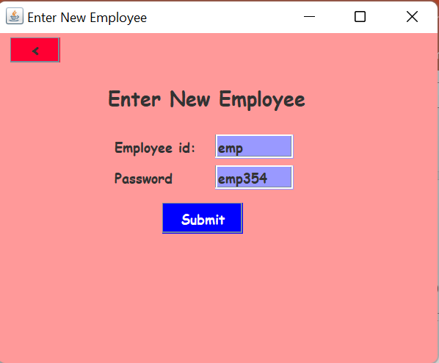
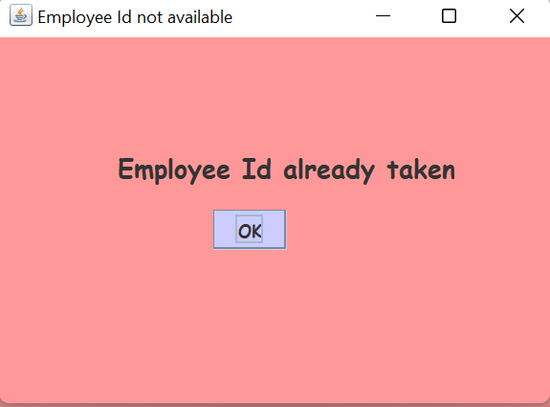

3. Enter New Executive(Id already taken )
As “emp ” Id already exists, an “Employee Id already taken ” error message is displayed.

Slide 18

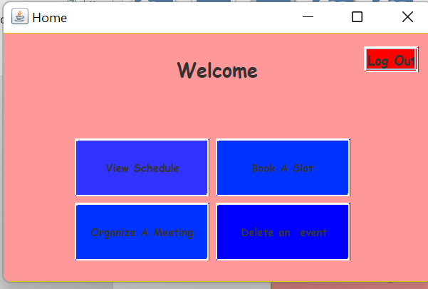

Logging in as an Executive(“emp”)
On entering correct credentials of an executive, the user is taken to executive dashboard as shown above.

Slide 19
Executive Dashboard
The executive is provided following features:-
1. View Schedule
2. Book a Slot
3. Organize Meeting
4. Delete an Event

Slide 20
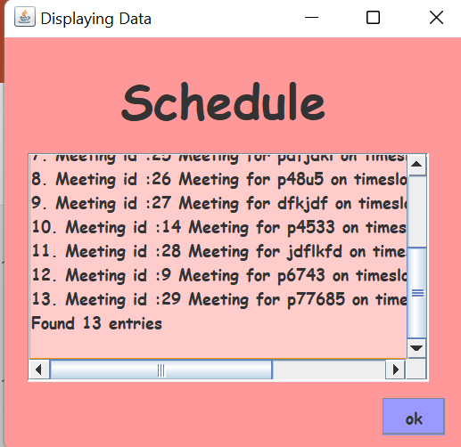
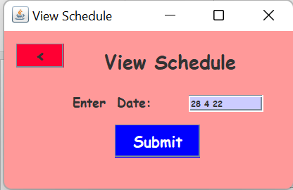

1. View Schedule
On entering a valid date , the executive is shown the schedule for that particular day.

Slide 21
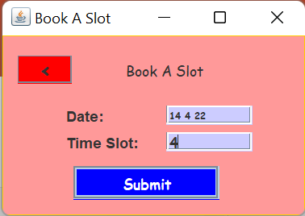
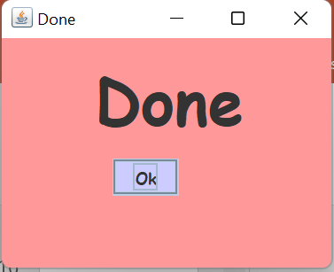

2. Book A Slot
On entering Valid date and time slot , the slot is booked (if not already booked)

Slide 22
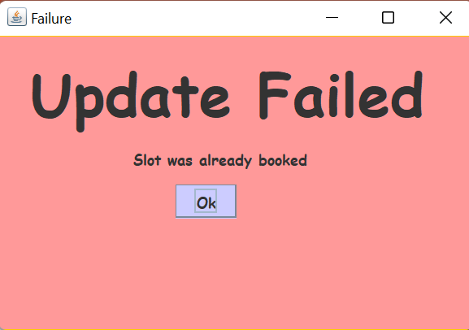

2. Book a Slot(Slot already engaged)
However trying to book an already booked/engaged slot results in a “Update failed ” message.

Slide 23
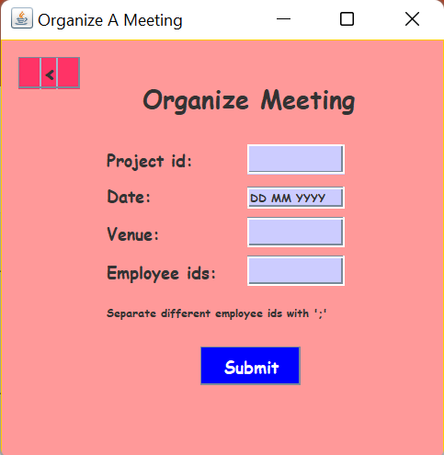
3. Organize A meeting
On clicking the Organize A meeting button, the User is taken to the screen shown below. Entering suitable details, the user can create a meeting.

Slide 24
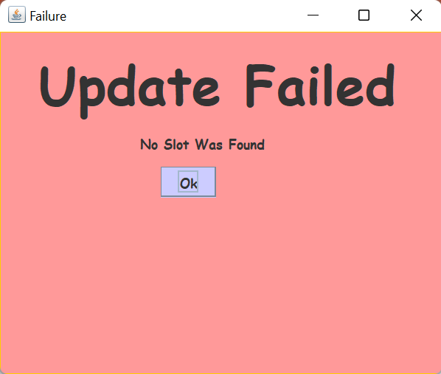
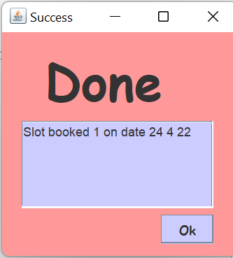


3. Organize A meeting
If details are all valid and a free slot was found.
If details were correct, but no slot was found.

Slide 25
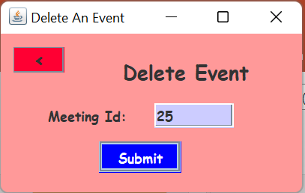
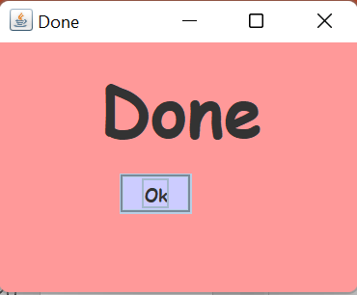

4. Delete an event
In order to resolve schedule clashes , the executive can also delete some of his events to reschedule the other events or to accommodate some more important events.
On clicking the delete an event button, the executive is take to following window which prompts him to enter a unique id that identifies the meeting he wants to delete. However if no such meeting exists, the system doesn’t show any error because if no such meeting exists, no need to delete it.

Slide 26
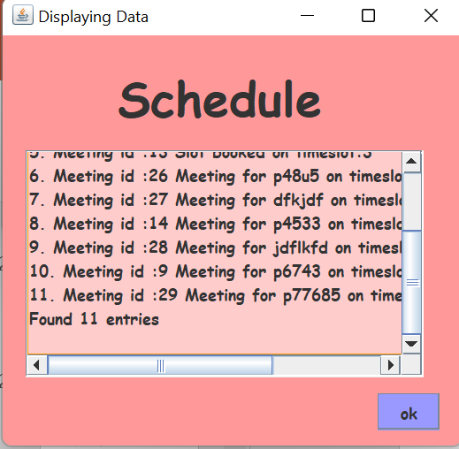
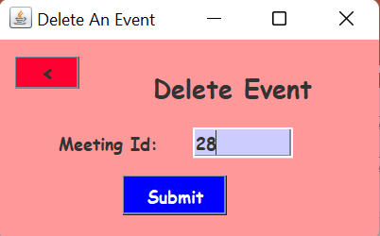
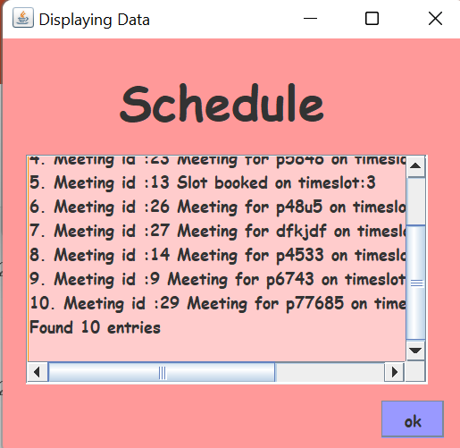


Deleting a meeting
Meeting with meeting id 28 no longer exists

Slide 27
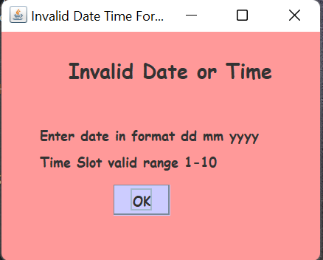
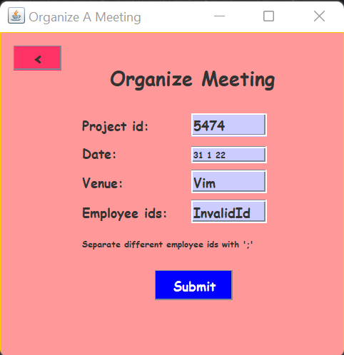
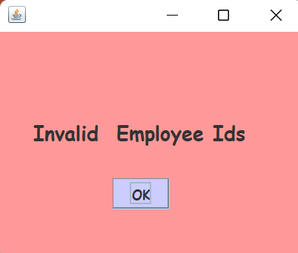

Invalid date, time and employee ids
In this software system, there is continuous monitoring of credentials added by the user, if the entered date, timeslot or employee ids are invalid then appropriate error messages are displayed.

Slide 28
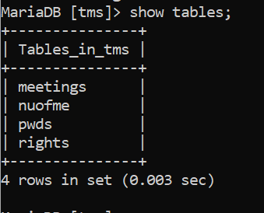
Schema of Database working at Backend
A database named TMS was created that supports this software application. It’s design is explained below:-
It consists of four tables namely :-
1. meetings (stores information related to all the meetings in organization)
2.nuofme(stores some persistent information related to application)
3. rights (stores rights information related to each of the employees, can only be modified by the admin)
4. pwds (stores information related to employees)

Slide 29
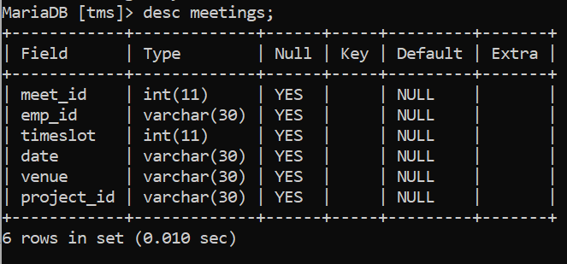
Schema of Database working at Backend
Schema of each of the tables is shown in next few slides:-
1. meetings

Slide 30
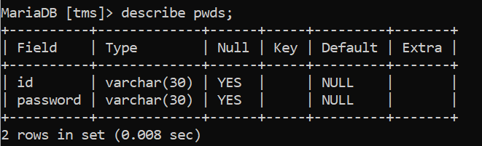
Schema of Database working at Backend
2. pwds
For the sake of simplicity, only two columns are there in the pwds table, However more columns like address, education etc. may be added.

Slide 31
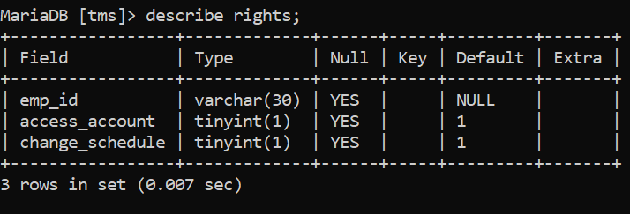
Schema of Database working at Backend
3. rights table
As already mentioned, this table stores the information related to access rights of executives in the organization.

